Slide 1
Web Technology Lecture - 09
Alim ul gias
Lecturer
Institute of information technology
University of dhaka

Slide 2
Content
PHP and MySQL Web Development

Slide 3
PHP and MySQL Web Development
When you install PHP, you can select from a number of extensions.
The MySQL support in PHP consists of a number of functions you can call to interact with MySQL, and here are some of them:

Slide 4
The mysql_connect() function opens a non-persistent MySQL connection.
This function returns the connection on success, or FALSE and
an error on failure.
Syntax
mysql_connect(server,user,pwd,newlink,clientflag)
Parameter Description
server Optional. Specifies the server to connect to (can also
include a port number, e.g. "hostname:port" or a path to a
local socket for the localhost).
Default value is "localhost:3306"
user Optional. Specifies the username to log in with. Default
value is the name of the user that owns the server process
pwd Optional. Specifies the password to log in with. Default is ""

Slide 5
The mysql_select_db() function sets the active MySQL database.
This function returns TRUE on success, or FALSE on failure.
Syntax
mysql_select_db(database,connection)
Parameter Description
database Required. Specifies the database to select.
connection Optional. Specifies the MySQL connection. If not specified,
the last connection opened by mysql_connect() or
mysql_pconnect() is used.

Slide 6
The mysql_query() function executes a query on a MySQL database.
This function returns the query handle for SELECT queries,
TRUE/FALSE for other queries, or FALSE on failure.
Syntax
mysql_query(query,connection)
Parameter Description
query Required. Specifies the SQL query to send (should not
end with a semicolon).
connection Optional. Specifies the MySQL connection. If not specified,
the last connection opened by mysql_connect() or
mysql_pconnect() is used.

Slide 7
The mysql_fetch_array() function returns a row from a recordset as an
associative array and/or a numeric array. This function gets a row from
the mysql_query() function and returns an array on success, or FALSE
on failure or when there are no more rows.
Syntax
mysql_fetch_array(data,array_type)
Parameter Description
data Required. Specifies which data pointer to use. The data
pointer is the result from the mysql_query() function
array_type Optional. Specifies what kind of array to return.
Possible values:
MYSQL_ASSOC - Associative array
MYSQL_NUM - Numeric array
MYSQL_BOTH - Default. Both associative and numeric array

Slide 8
The mysql_fetch_object() function returns a row from a recordset as an object.
This function gets a row from the mysql_query() function and returns an object
on success, or FALSE on failure or when there are no more rows.
Syntax
mysql_fetch_object(data)
Parameter Description
data Required. Specifies which data pointer to use. The data
pointer is the result from the mysql_query() function
Tips and Notes
Note: Each subsequent call to mysql_fetch_object() returns the
next row in the recordset.

Slide 9
The mysql_affected_rows() function returns the number of affected rows
in the previous MySQL operation. This function returns the number of
affected rows on success, or -1 if the last operation failed.
Syntax
mysql_affected_rows(connection)
Parameter Description
connection Optional. Specifies the MySQL connection. If not specified,
the last connection opened by mysql_connect() or
mysql_pconnect() is used.

Slide 10
The mysql_num_rows() function returns the number of rows in a recordset.
This function returns FALSE on failure.
Syntax
mysql_num_rows(data)
Parameter Description
data Required. Specifies which data pointer to use.
The data pointer is the result from the mysql_query() function

Slide 11
The mysql_result() function returns the value of a field in a recordset.
This function returns the field value on success, or FALSE on failure.
Syntax
mysql_result(data,row,field)
Parameter Description
data Required. Specifies which result handle to use. The data
pointer is the return from the mysql_query() function
row Required. Specifies which row number to get.
Row numbers start at 0

Slide 12
field Optional. Specifies which field to get. Can be field offset,
field name or table.fieldname. If this parameter is not defined
mysql_result() gets the first field from the specified row.
Tips and Notes
This function is slower than mysql_fetch_row(),
mysql_fetch_array(), mysql_fetch_assoc() and
mysql_fetch_object().

Slide 13
The mysql_error() function returns the error description of the last
MySQL operation. This function returns an empty string ("") if no error occurs.
Syntax
mysql_error(connection)
Parameter Description
connection Optional. Specifies the MySQL connection. If not specified,
the last connection opened by mysql_connect() or
mysql_pconnect() is used.

Slide 14
The mysql_close() function closes a non-persistent MySQL connection.
This function returns TRUE on success, or FALSE on failure.
Syntax
mysql_close(connection)
Parameter Description
connection Optional. Specifies the MySQL connection to close.
If not specified, the last connection opened by
mysql_connect() is used.

Slide 15
die — Equivalent to exit()
Description
This language construct is equivalent to exit().

Slide 16
exit — Output a message and terminate the current script
Description
void exit ([ string $status ] )
void exit ( int $status )
Terminates execution of the script.
Parameters
status
If status is a string, this function prints the status just before exiting.
If status is an integer, that value will also be used as the exit status.
Exit statuses should be in the range 0 to 254, the exit status 255 is
reserved by PHP and shall not be used. The status 0 is used to
terminate the program successfully.

Slide 17
A typical web database transaction consists of the following stages, which are numbered in the Figure 1:
1. A user’s web browser issues an HTTP request for a particular web page. For example, using an HTML form, she might have requested a search for all books at MikkeliOnlineProfessionalBooks.com written by Leila Karjalainen. The search results page is called results.php.
2. The web server receives the request for results.php, retrieves the file, and passes it to the PHP engine for processing.

Slide 18
1
Browser
Web Server
6
5
2
3
MySQL Server
PHP Engine
4

Slide 19
3. The PHP engine begins parsing the script. Inside the script is a command to connect to the database and execute a query (perform the search for books). PHP opens a connection to the MySQL server and sends on the appropriate query.
4. The MySQL server receives the database query, processes it, and sends the results - a list of books - back to the PHP engine.
5. The PHP engine finishes running the script, which usually involves formatting the query results nicely in HTML. It then returns the resulting HTML to the web server.

Slide 20
6. The web server passes the HTML back to the browser, where the user can see the list of books she requested.
The above described process is basically the same regardless of which scripting engine or database server you use.
Sometimes the web server, PHP engine, and database server all run on the same machine.
However, it is quite common for the database server to run on a different machine. You might do this for reasons of security, increased capacity, or load spreading. From a development perspective, this approach is much the same to work with.

Slide 21
First example reads in and displays the contents of the Friend table from the database Future.
Our script will do the following jobs:
Set up a connection to the appropriate database
Query the database table
Retrieve the results
Present the results back to the user
First we need to create the needed database and database table – this time we will do it directly using MySQL Query Browser:

Slide 22
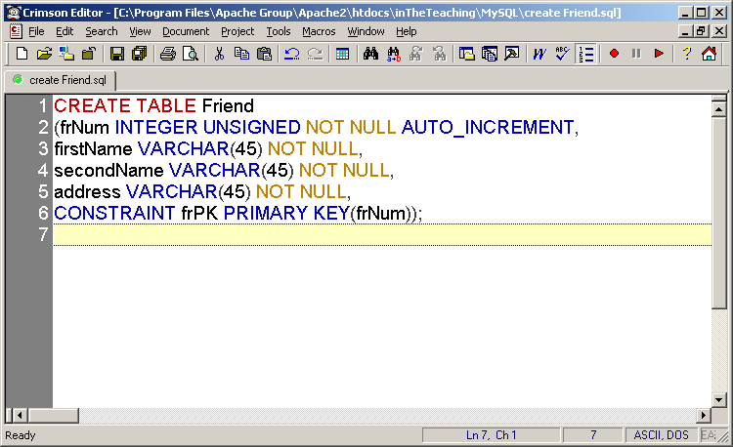

Slide 23
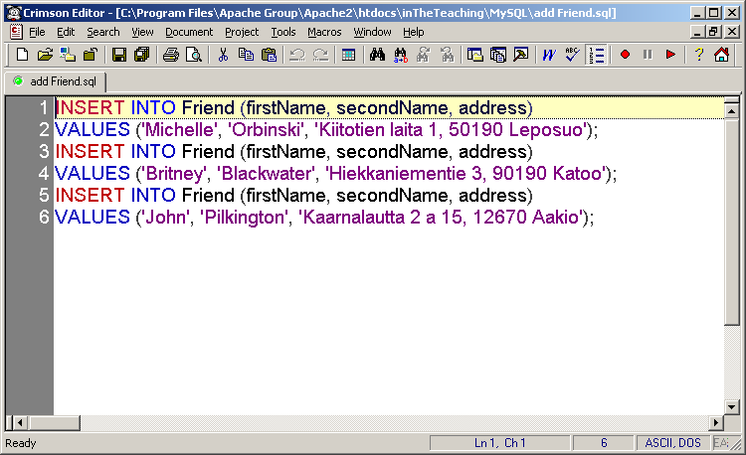

Slide 24
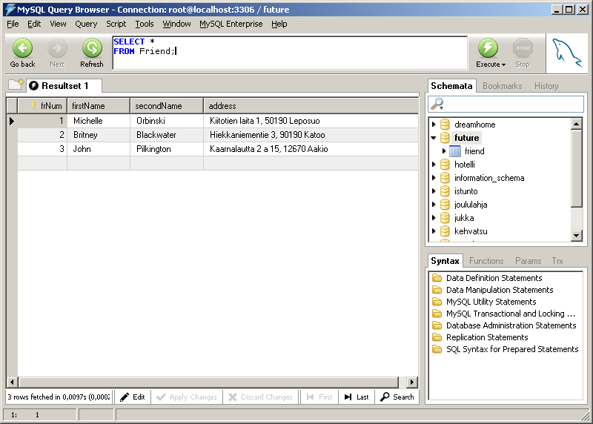

Slide 25
Next the PHP script:

Slide 26
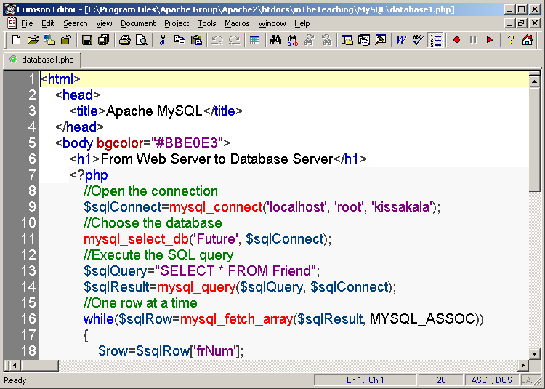

Slide 27
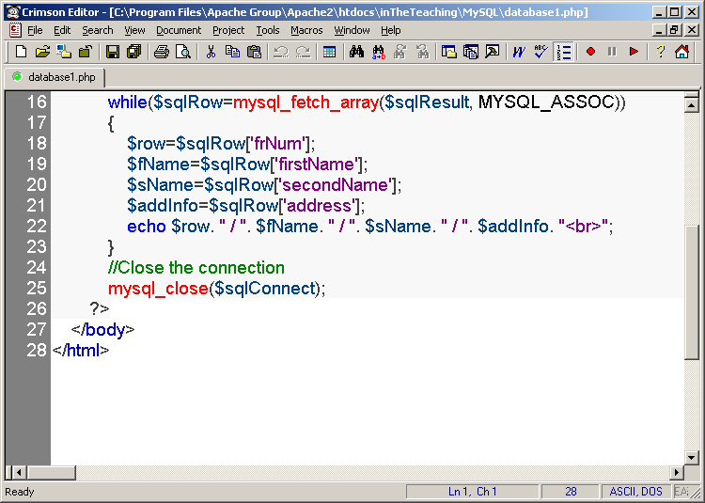

Slide 28
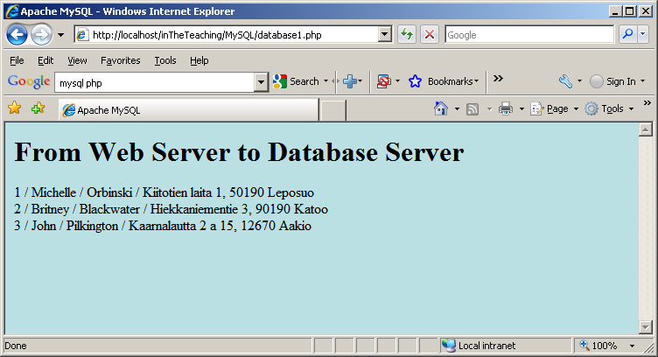
…and what you can see from the browser:

Slide 29
‘$sqlResult = mysql_query...’
When you select items from a database using mysql_query(), the data is returned as a MySQL result. Since we want to use this data in our program we need to store it in a variable. $sqlResult now holds the result from our mysql_query().

Slide 30
‘while($sqlRow = mysql_fetch_array( $sqlResult…)’
The mysql_fetch_array function gets the next-in-line associative array from a MySQL result. By putting it in a while loop it will continue to fetch the next array until there is no next array to fetch. This function can be called as many times as you want, but it will return FALSE when the last associative array has already been returned.
By placing this function within the conditional statement of the while loop, we can “kill” two birds with one stone:

Slide 31
1. We can retrieve the next associative array from our MySQL resource, $sqlResult, so that we can print out the retrieved information.
2. We can tell the while loop to stop printing out information when the MySQL resource has returned the last array, as FALSE is returned when it reaches the end and this will cause the while loop to halt.
A resource is a special variable, holding a reference to an external resource.

Slide 32
In the above script, we have accessed the firstName column like this: $sqlRow[‘firstName’]. That can also be done by using integer indexing:

Slide 33
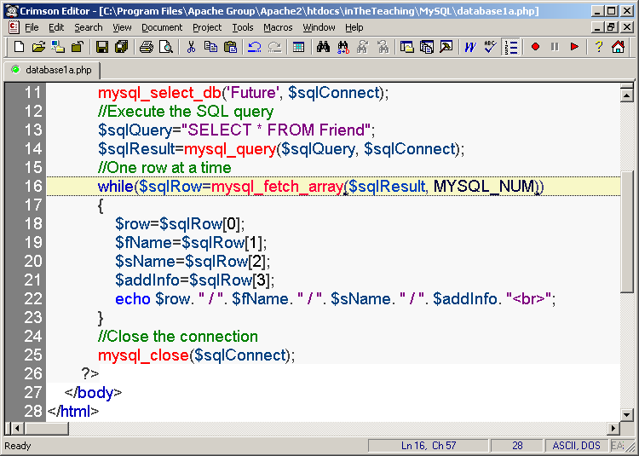

Slide 34
Or finding out the number of rows in a recordset:

Slide 35
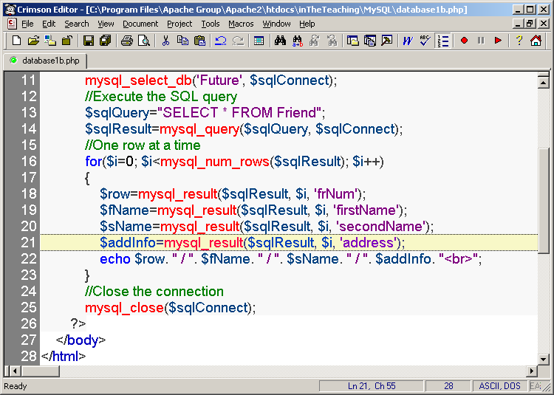

Slide 36


Slide 37
Or returning a row from a recordset as an object

Slide 38
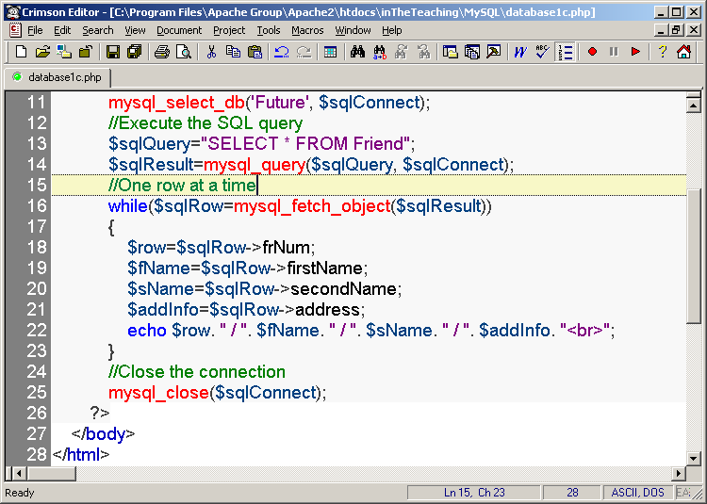

Slide 39


Slide 40
A minor modification to the original example: let’s make it display a message if there is an error when connecting to the database server:

Slide 41
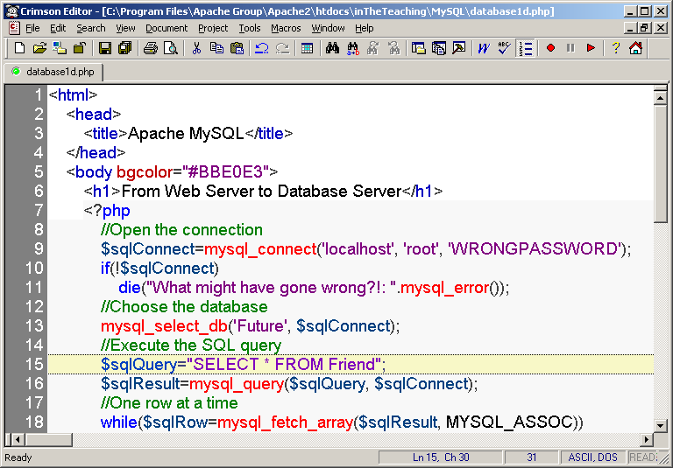

Slide 42
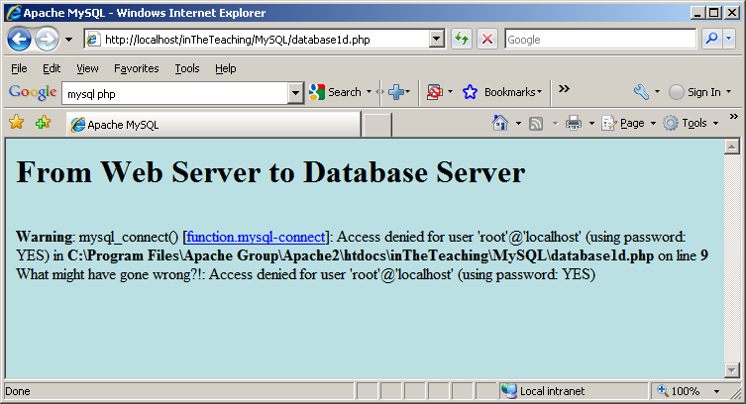

Slide 43
So it seems that die() needs no arguments because mysql_connect() is able to give the same information:

Slide 44
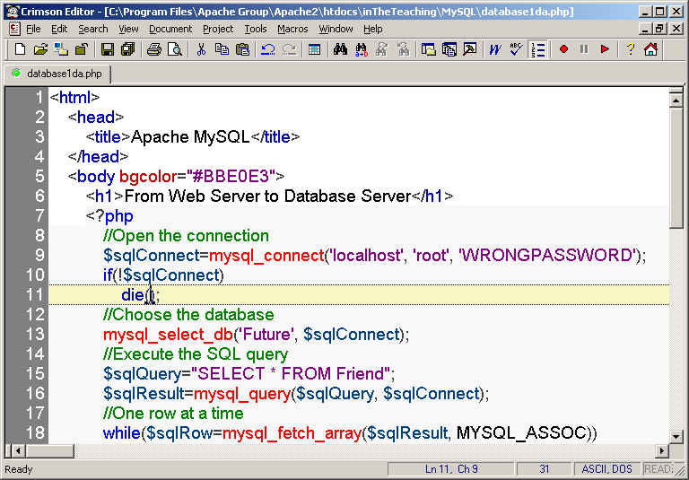

Slide 45
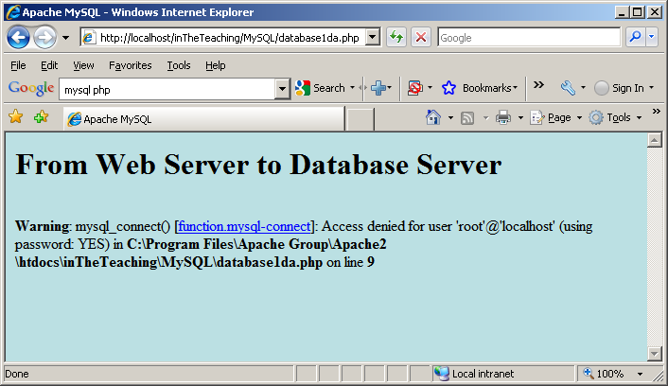

Slide 46
A minor modification to the original example: let’s make it display a message if there is an error when selecting the database we want to use:

Slide 47
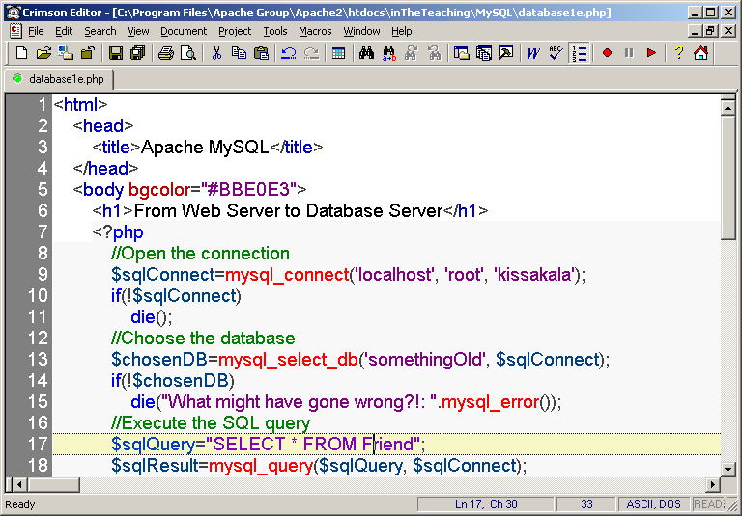

Slide 48
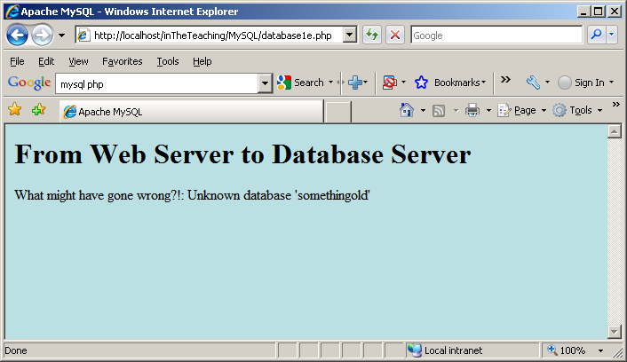

Slide 49
In the next example we will insert one row to the Friend table. First directly from web server to the database server without any user interface.

Slide 50
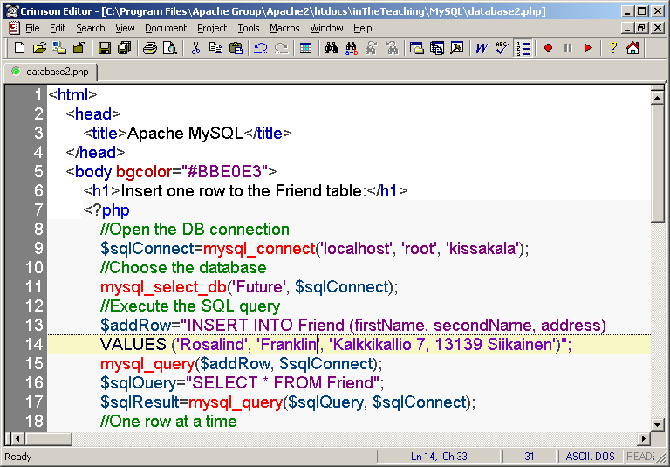

Slide 51
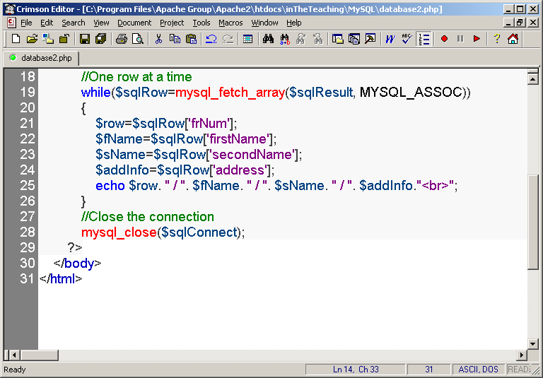

Slide 52
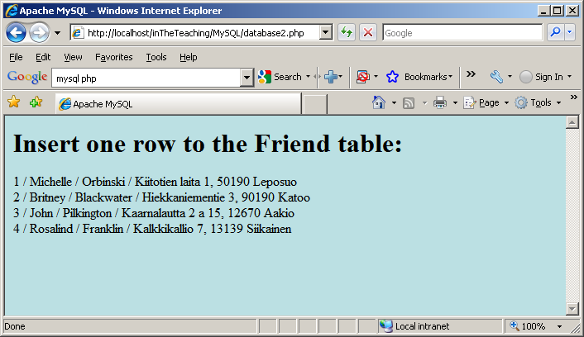

Slide 53
Abit more complex task: Insert data from a form into a database:
Now we will create an HTML form that can be used to add new records to the Friend table, file database3.html:

Slide 54
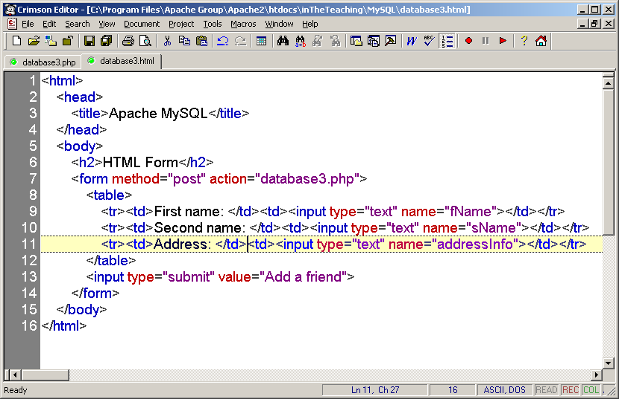

Slide 55
When a user clicks the submit button in the HTML form in the example above, the form data is sent to database3.php.
The database3.php file connects to a database, and retrieves the values from the form with the PHP $_POST variables.
Then, the mysql_query() function executes the INSERT INTO statement, and a new record will be added to the Friend table.
Here is the database3.php page:

Slide 56
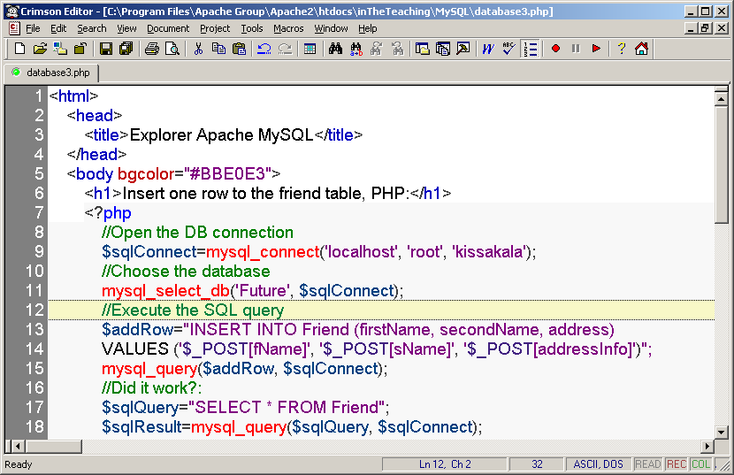

Slide 57
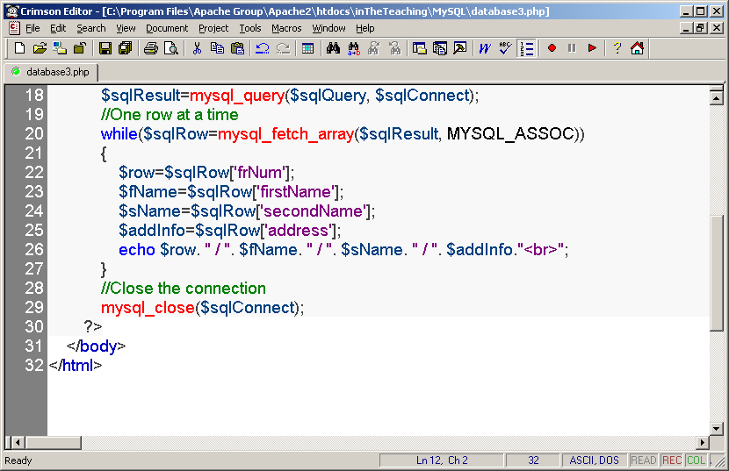

Slide 58
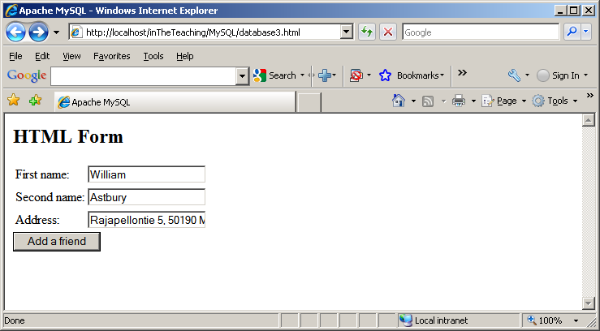

Slide 59
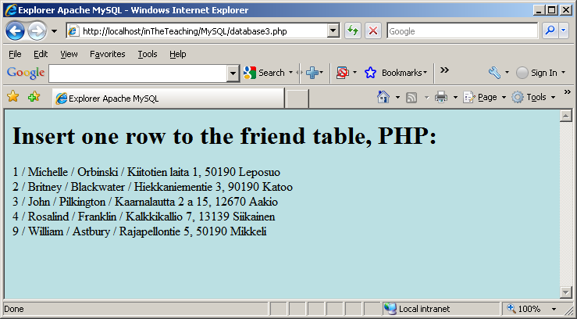

Slide 60
From the previous slide it can be seen that the primary key jumps from 4 to 9 - that is because there were some errors when testing the example…
The primary key can be modified directly using MySQL Query Browser (Naturally UPDATES can be done using our HTML user interface) if the current situation annoys someone:

Slide 61
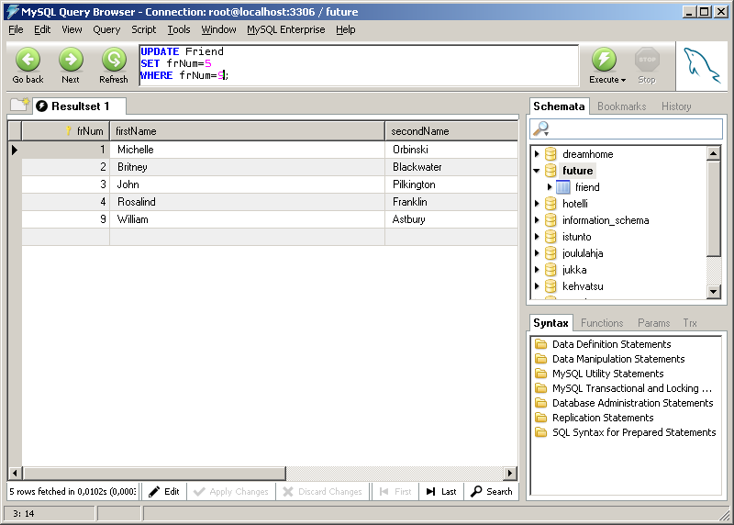

Slide 62
A minor modification to the database3.php example: Let’s test that all the HTML fields have at least something inputted:

Slide 63
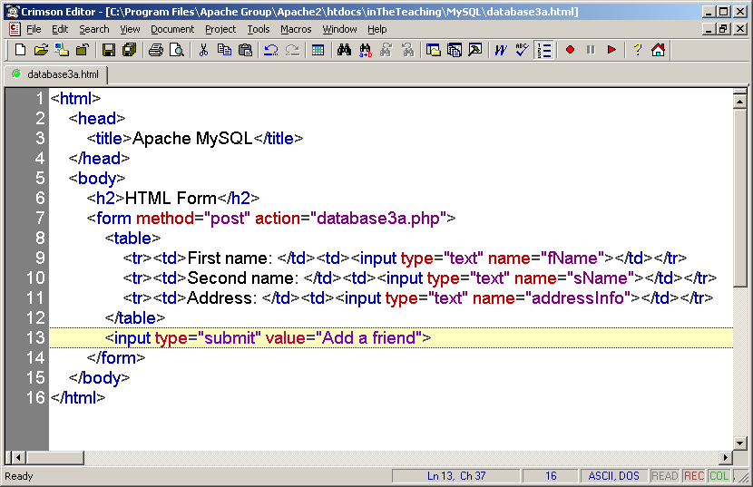

Slide 64
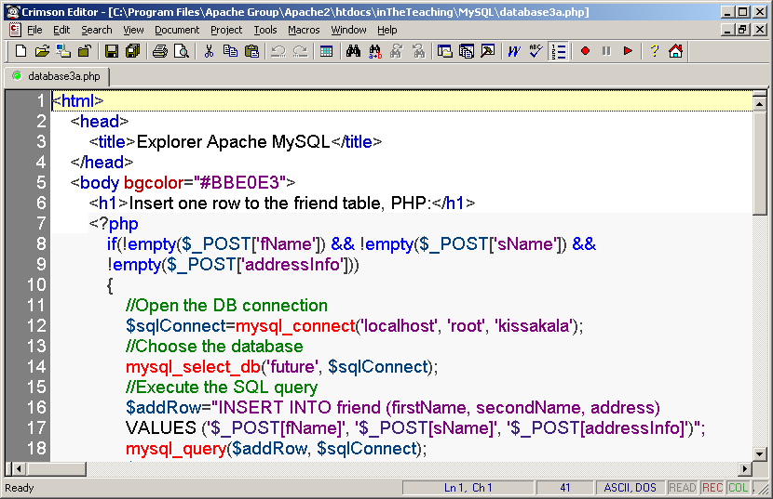

Slide 65
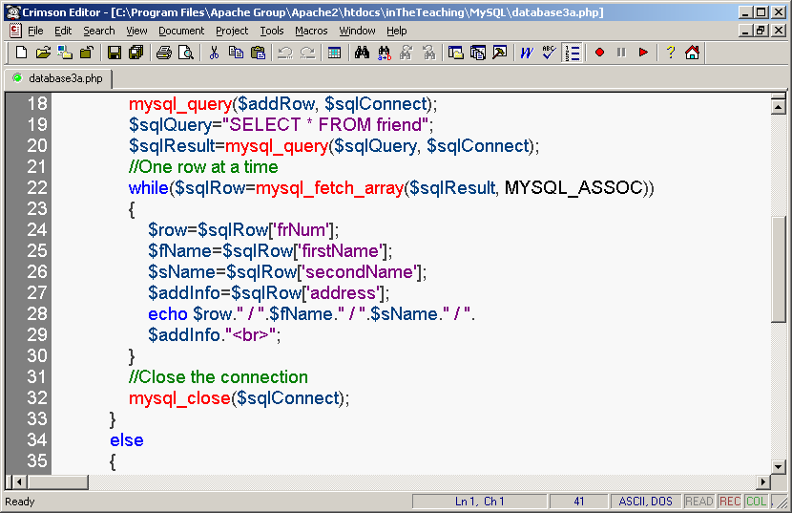

Slide 66
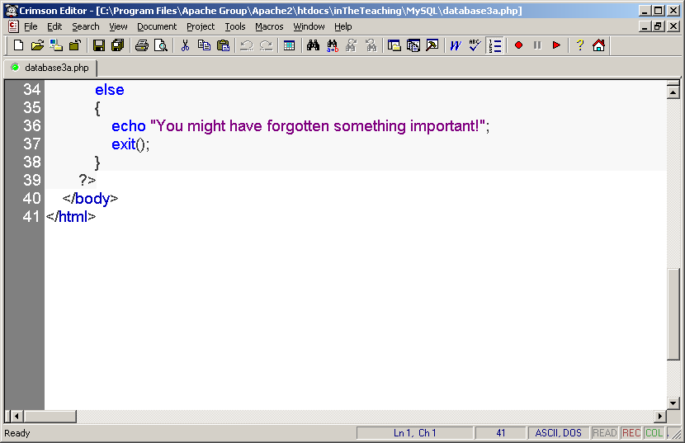

Slide 67
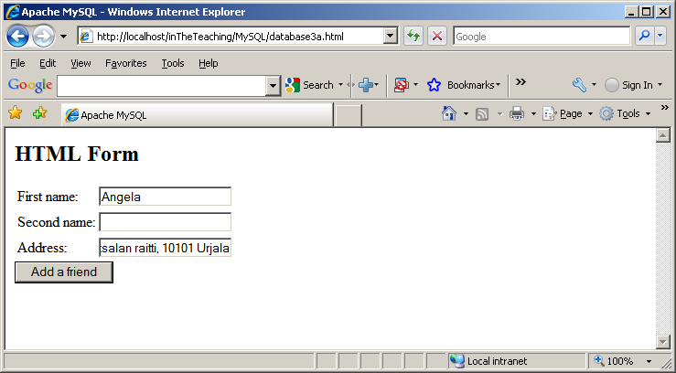

Slide 68
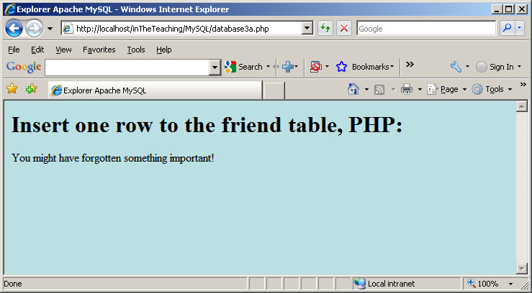

Slide 69
A minor modification to the database3.php example: putting it all in one page.
The first test: has the user submitted the form?
Second test: Is there something in every field?

Slide 70
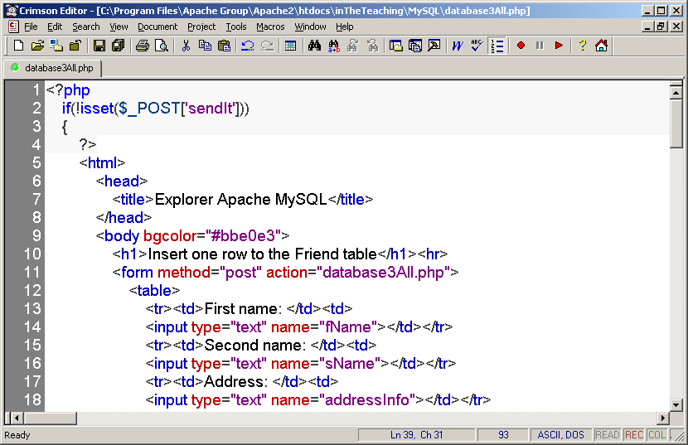

Slide 71
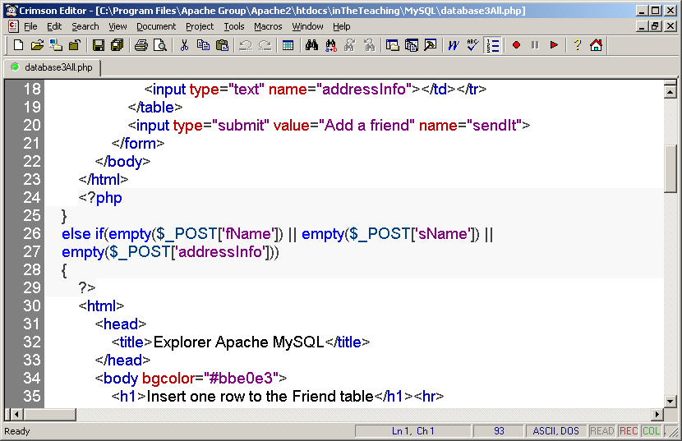

Slide 72
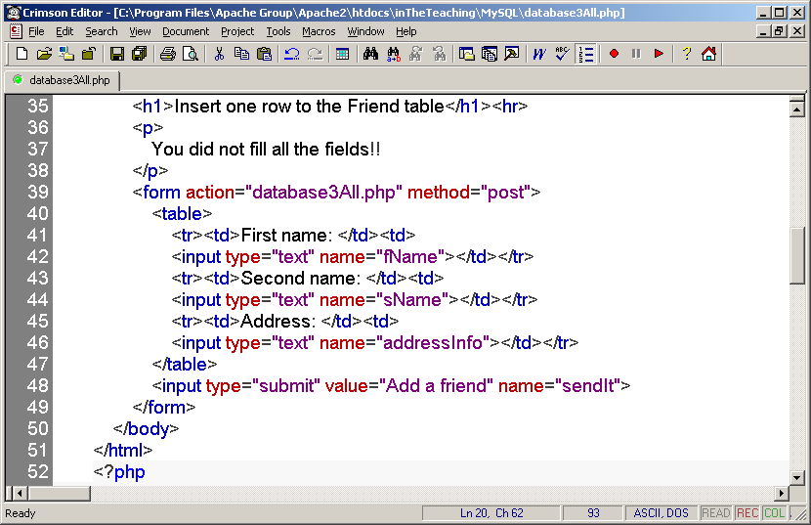

Slide 73
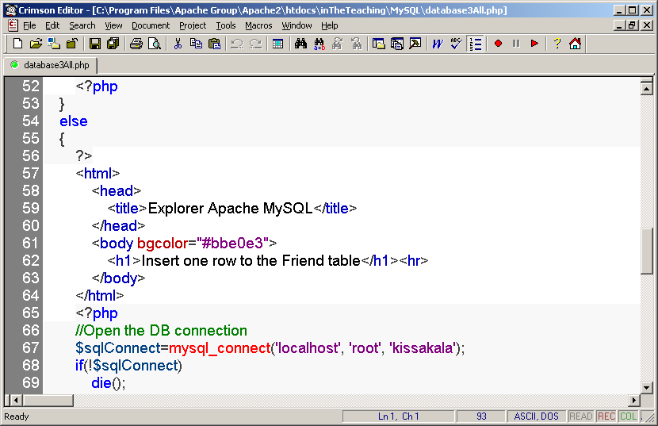

Slide 74
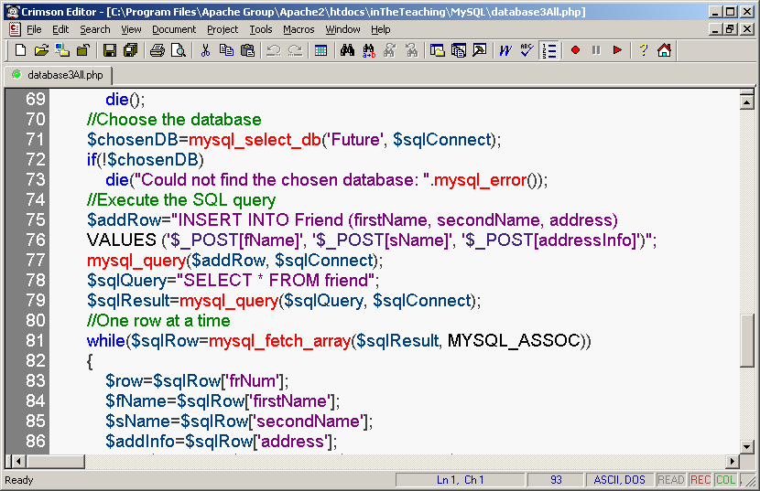

Slide 75
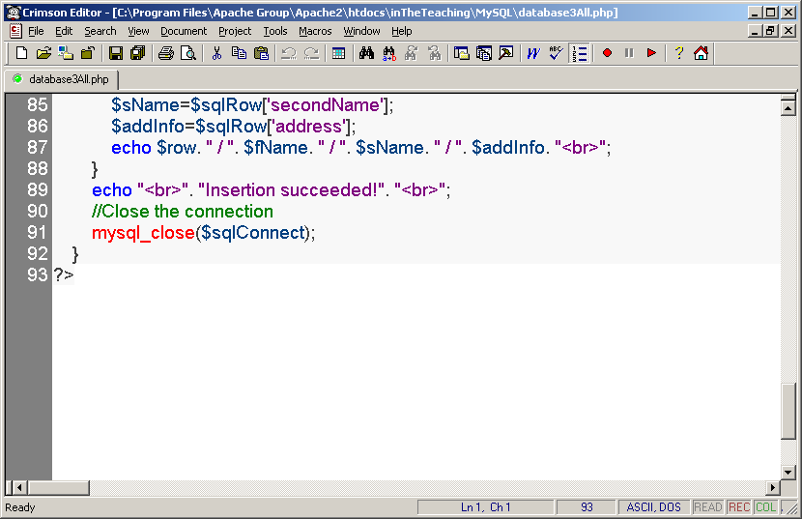

Slide 76
If every field does have something:

Slide 77
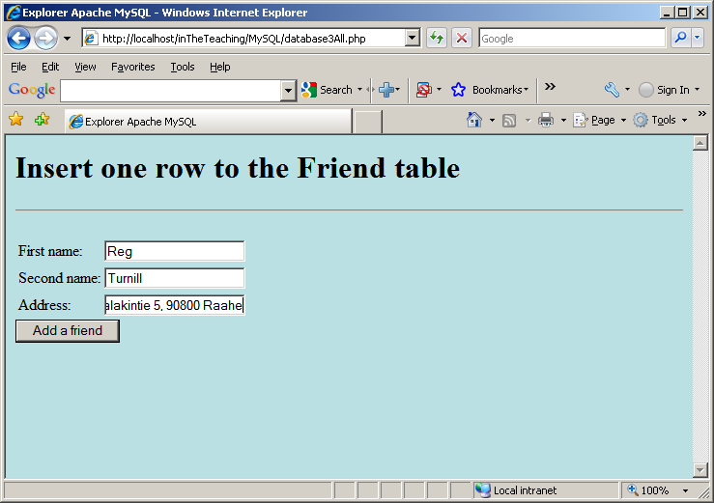

Slide 78
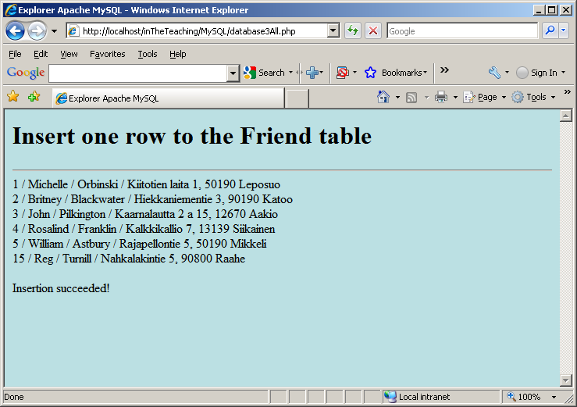

Slide 79
If there is one or more empty fields:

Slide 80


Slide 81
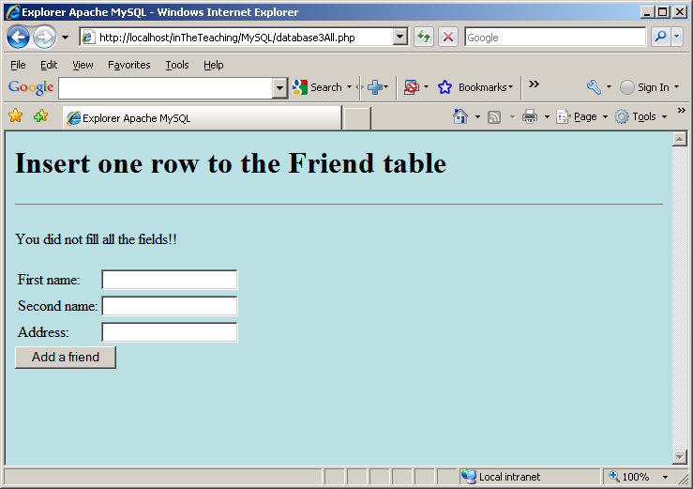

Slide 82
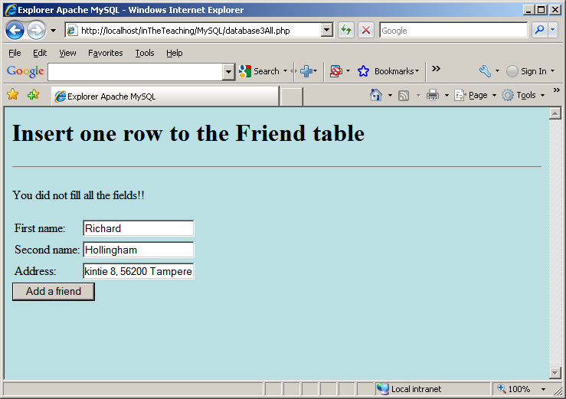

Slide 83
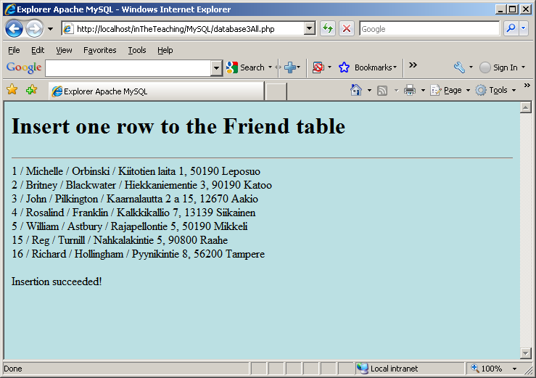

Slide 84
Update data from a form into a database:
Now we will create an HTML form that can be used to update one column in the Friend table, file update1.php. We have arbitrarily chosen to update the first name of the person.
The first test: has the user submitted the form?
Second test: is there something in every field?
Third test: is the new first name longer than the field domain permits?

Slide 85
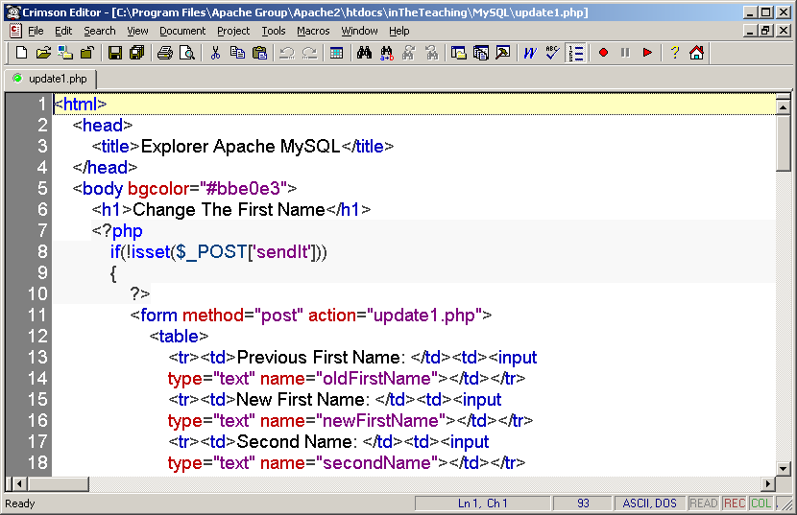

Slide 86
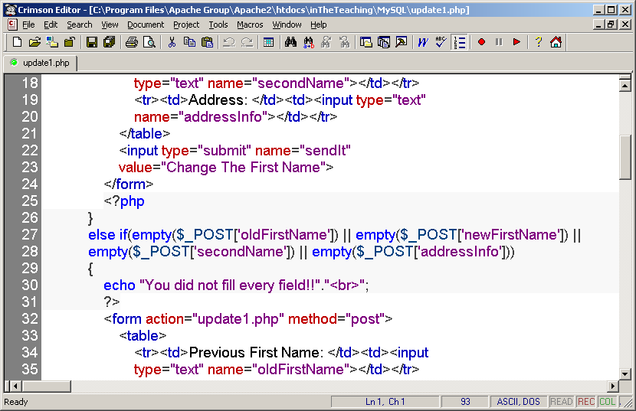

Slide 87
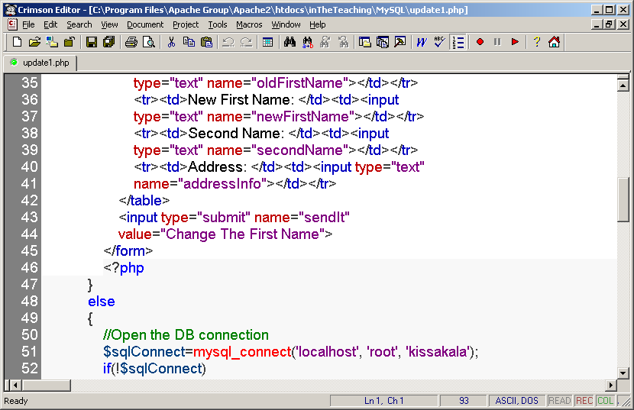

Slide 88
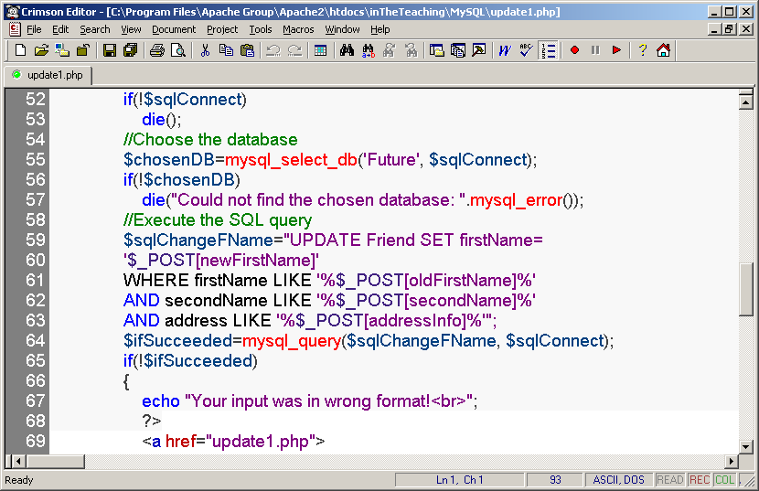

Slide 89
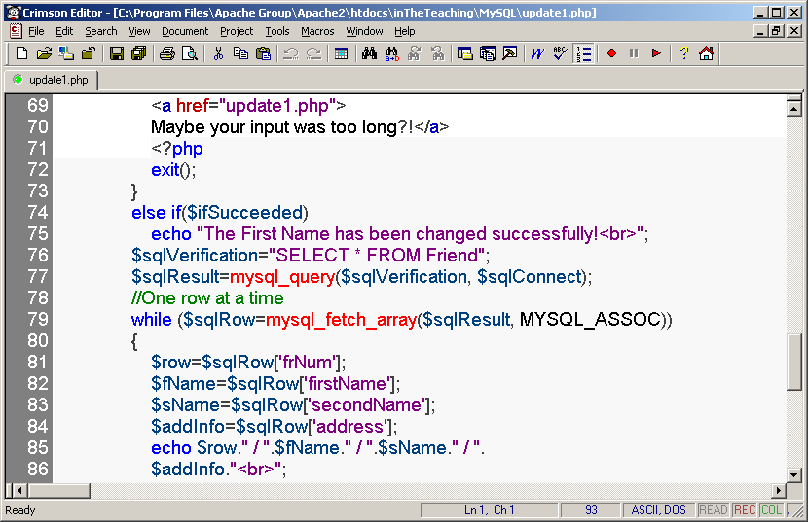

Slide 90
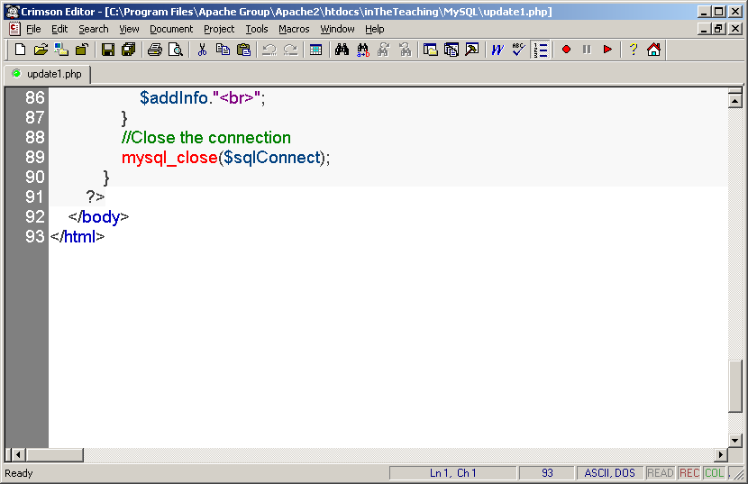

Slide 91
Let’s find out what there is in the table Friend:

Slide 92
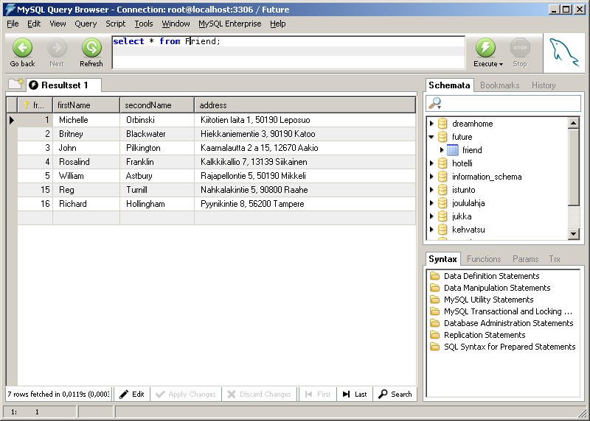

Slide 93
The task is to update the first name Rosalind to Rosalind Elsie:

Slide 94
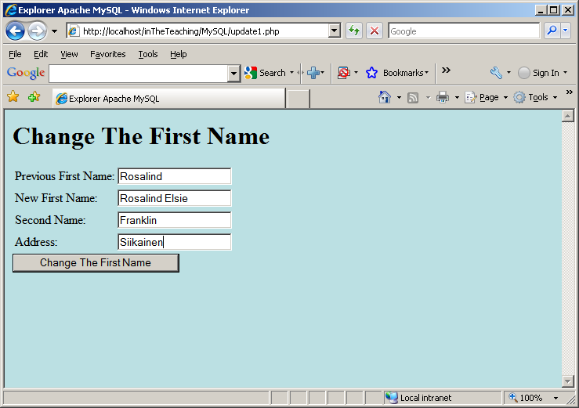

Slide 95
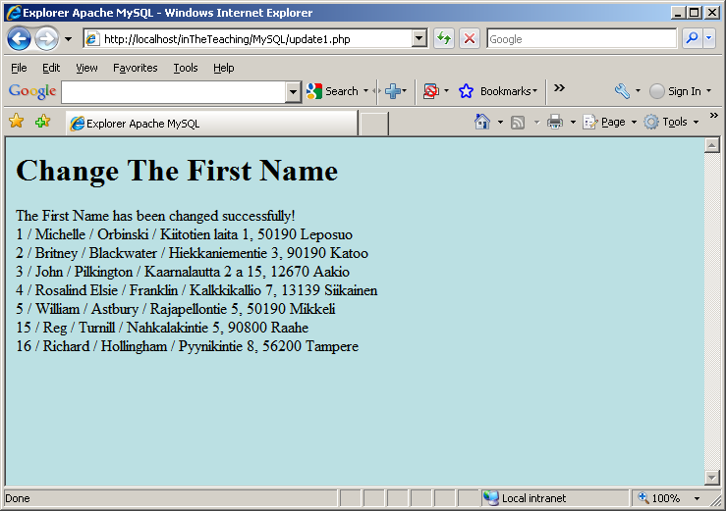

Slide 96
The third test: has the user inputted too long a name?:

Slide 97

New First Name: Longer than 45 character constants

Slide 98



Slide 99
One more detail from the previous example: the first parameter of the mysql_query() is UPDATE statement.
UPDATE and DELETE statements behave in the same way in those kinds of situations: if there are no rows to be updated or deleted, then there would not come any warnings or errors back:

Slide 100


Slide 101


Slide 102
Definitely we need to improve the source code:

Slide 103


Slide 104


Slide 105
Let us test the modification. The second name and the address are valid values:

Slide 106


Slide 107


Slide 108
The following example selects the same data as the example above, but will display the data in an HTML table:

Slide 109


Slide 110


Slide 111


Slide 112
End

